Slide 1
Introduction – The Database Environment
Sumber: Silberschatz, Korth and Sudarshan, Database System Concepts, 6th Ed.
Jeffrey A. Hoffer, Mary B. Prescott, Fred R. McFadden, Modern Database Management, 8th Ed.
Program Studi Teknik Informatika
Institut Teknologi Sumatera

Slide 2
Learning Outcomes
Describe how humans gain access to information and data to support their needs
Compare and contrast information with data and knowledge
Identify issues of data persistence to an organization
Explain the characteristics that distinguish the database approach from the traditional approach of programming with data files
Cite the basic goals, functions, models, components, applications, and social impact of database systems
Identify major DBMS functions and describe their role in a database system
Explain the concept of data independence and its importance in a database system
Notes:
- data persistence = data yg konsisten/teguh tidak berubah informasinya
Cite = memetic

Slide 3
Definitions
Database: organized collection of logically related data
Data: stored representations of meaningful objects and events
Structured: numbers, text, dates
Unstructured: images, video, documents
Information: data processed to increase knowledge in the person using the data
Metadata: data that describes the properties and context of user data

Slide 4
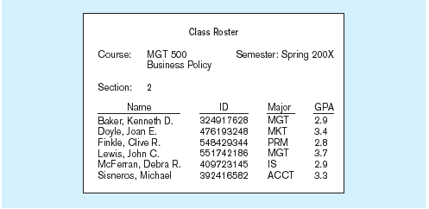
Data in context
Context helps users understand data

Slide 5
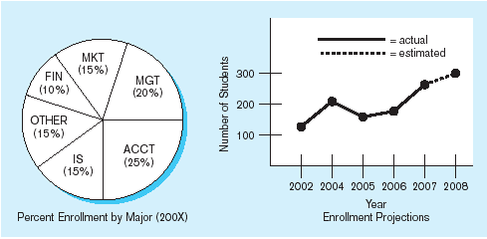
Summarized data
Graphical displays turn data into useful information that managers can use for decision making and interpretation

Slide 6
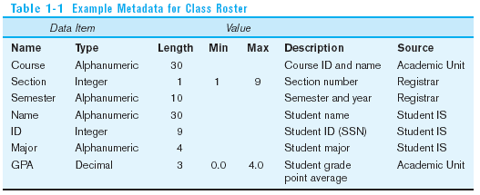
Descriptions of the properties or characteristics of the data, including data types, field sizes, allowable values, and data context

Slide 7
Why Database Systems?
Most applications deal with a lot of data
Banking: transactions
Airlines: reservations, schedules
Universities: registration, grades
Sales: customers, products, purchases
Online retailers: order tracking, customized recommendations
Manufacturing: production, inventory, orders, supply chain
Human resources: employee records, salaries, tax deductions
The data can be very large.
These applications touch all aspects of our lives.

Slide 8
Example: Application for A University
Application program examples:
Add new students, instructors, and courses.
Register students for courses, and generate class rosters.
Assign grades to students, compute grade point averages (GPA), and generate transcripts.
In the early days, these applications were built directly on top of file systems
Notes:
8

Slide 9
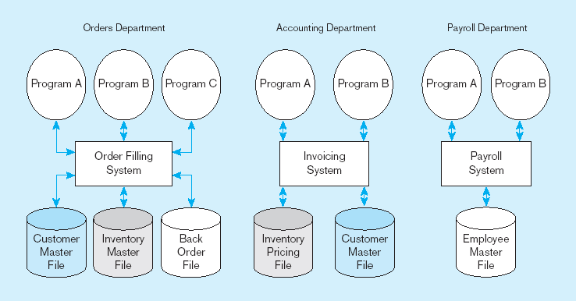
Example: old file processing systems at Pine Valley Furniture Company
Duplicate Data

Slide 10
Drawbacks of using file systems to store data
Data redundancy and inconsistency
Multiple file formats, duplication of information in different files
Problems:
Waste of space to have duplicate data
Causes more maintenance headaches
The biggest problem:
Data changes in one file could cause inconsistencies
Compromises in data integrity
Difficulty in accessing data → lengthy development times
Need to write a new program to carry out each new task

Slide 11
Drawbacks of using file systems to store data
Program-Data Dependence
All programs maintain metadata for each file they use
Problems:
Each application programmer must maintain his/her own data
Each application program needs to include code for the metadata of each file
Each application program must have its own processing routines for reading, inserting, updating, and deleting data
Lack of coordination and central control
Non-standard file formats
Data isolation/limited data sharing
Multiple files and formats
No centralized control of data
Integrity problems
Integrity constraints (e.g., account balance > 0) become “buried” in program code rather than being stated explicitly
Hard to add new constraints or change existing ones

Slide 12
Drawbacks of using file systems to store data (cont.)
Atomicity of updates
Failures may leave database in an inconsistent state with partial updates carried out
Example: Transfer of funds from one account to another should either complete or not happen at all
Concurrent access by multiple users
Concurrent access needed for performance
Uncontrolled concurrent accesses can lead to inconsistencies
Example: Two people reading a balance (say 100) and updating it by withdrawing money (say 50 each) at the same time
Security problems
Hard to provide user access to some, but not all, data

Slide 13

SOLUTION: The DATABASE Approach
Central repository of shared data
Data is managed by a controlling agent
Stored in a standardized, convenient form
Requires a Database Management System (DBMS)

Slide 14
Database Management System
A software system that is used to create, maintain, and provide controlled access to user databases
Order Filing
System
Central database
Contains employee,
order, inventory,
pricing, and
customer data
Invoicing
System
DBMS
Payroll
System
DBMS manages data resources like an operating system manages hardware resources

Slide 15

Advantages of the Database Approach
Program-data independence
Planned data redundancy
Improved data consistency
Improved data sharing
Increased application development productivity
Enforcement of standards
Improved data quality
Improved data accessibility and responsiveness
Reduced program maintenance
Improved decision support

Slide 16
Costs and Risks of the Database Approach
New, specialized personnel
Installation and management cost and complexity
Conversion costs
Need for explicit backup and recovery
Organizational conflict

Slide 17
Levels of Abstraction
Physical level: describes how a record (e.g., customer) is stored.
Logical level: describes data stored in database, and the relationships among the data.
type instructor = record
ID : string; name : string; dept_name : string; salary : integer;
end;
View level: application programs hide details of data types. Views can also hide information (such as an employee’s salary) for security purposes.
Notes:
17

Slide 18
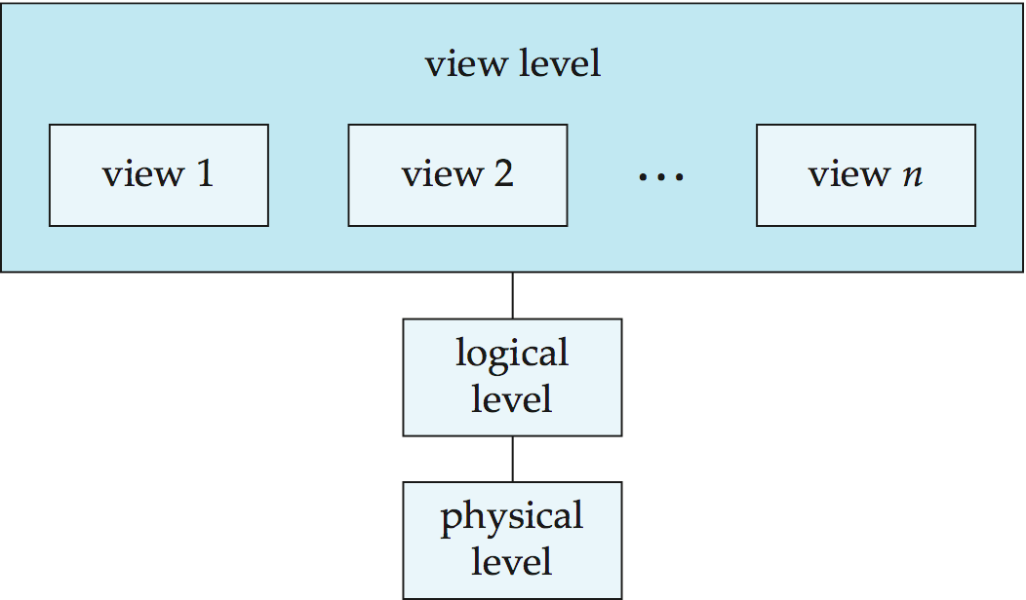
View of Data
An architecture for a database system
Notes:
18

Slide 19
Instances and Schemas
Similar to types and variables in programming languages
Schema – the logical structure of the database
Example: The database consists of information about a set of customers and accounts and the relationship between them
Analogous to type information of a variable in a program
Physical schema: database design at the physical level
Logical schema: database design at the logical level
Instance – the actual content of the database at a particular point in time
Analogous to the value of a variable
Physical Data Independence – the ability to modify the physical schema without changing the logical schema
Applications depend on the logical schema
In general, the interfaces between the various levels and components should be well defined so that changes in some parts do not seriously influence others.
Notes:
19

Slide 20
Data Models
A collection of tools for describing
Data
Data relationships
Data semantics
Data constraints
Relational model
Entity-Relationship data model (mainly for database design)
Object-based data models (Object-oriented and Object-relational)
Semistructured data model (XML)
Other older models:
Network model
Hierarchical model
Notes:
20

Slide 21
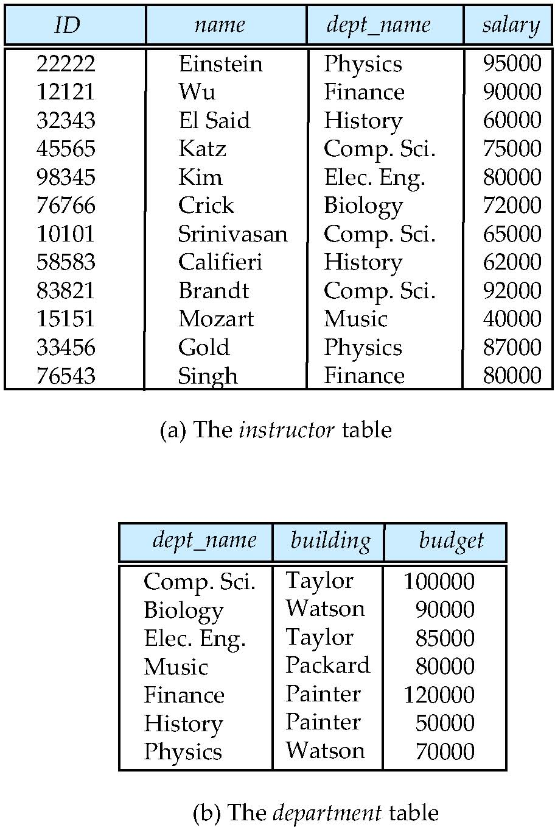
Relational Model
Relational model
Example of tabular data in the relational model
Columns
Rows
Notes:
21

Slide 22
A Sample Relational Database
Notes:
22

Slide 23
Data Manipulation Language (DML)
Language for accessing and manipulating the data organized by the appropriate data model
DML also known as query language
Two classes of languages
Procedural – user specifies what data is required and how to get those data
Declarative (nonprocedural) – user specifies what data is required without specifying how to get those data
SQL is the most widely used query language
Notes:
23
- Prosedural = mirip pemrograman C, Pascal
- Non Presedural = SQL

Slide 24
Data Definition Language (DDL)
Specification notation for defining the database schema
Example: create table instructor ( ID char(5), name varchar(20), dept_name varchar(20), salary numeric(8,2))
DDL compiler generates a set of table templates stored in a data dictionary
Data dictionary contains metadata (i.e., data about data)
Database schema
Integrity constraints
Primary key (ID uniquely identifies instructors)
Referential integrity (references constraint in SQL)
e.g. dept_name value in any instructor tuple must appear in department relation
Authorization
Notes:
24
- Authorization = Bagaimana dan siapa yg berhak mengakses sebuah data

Slide 25
SQL
SQL: widely used non-procedural language
Example: Find the name of the instructor with ID 22222 select name from instructor where instructor.ID = ‘22222’
Example: Find the ID and building of instructors in the Physics dept.
select instructor.ID, department.building from instructor, department where instructor.dept_name = department.dept_name and department.dept_name = ‘Physics’
Application programs generally access databases through one of
Language extensions to allow embedded SQL
Application program interface (e.g., ODBC/JDBC) which allow SQL queries to be sent to a database
Notes:
25

Slide 26
Database Design
The process of designing the general structure of the database:
Logical Design – Deciding on the database schema. Database design requires that we find a “good” collection of relation schemas.
Business decision – What attributes should we record in the database?
Computer Science decision – What relation schemas should we have and how should the attributes be distributed among the various relation schemas?
Physical Design – Deciding on the physical layout of the database
Notes:
26
Untuk membuat design database yg baik kita harus menemukan atau membuat sekumpulan (koleksi) relasi
Keputusan yg ada dalam instansi > data apa yg akan disimpan dalam database
Relasi apa yg harus dibuat antar objek
Skema fisik > fisik layout database. Beda dg lapisan fisik loh ya. Lapisan fisik itu ada di harddisk. Perhatikan perbedaan SKEMA dan LAPISAN.

Slide 27
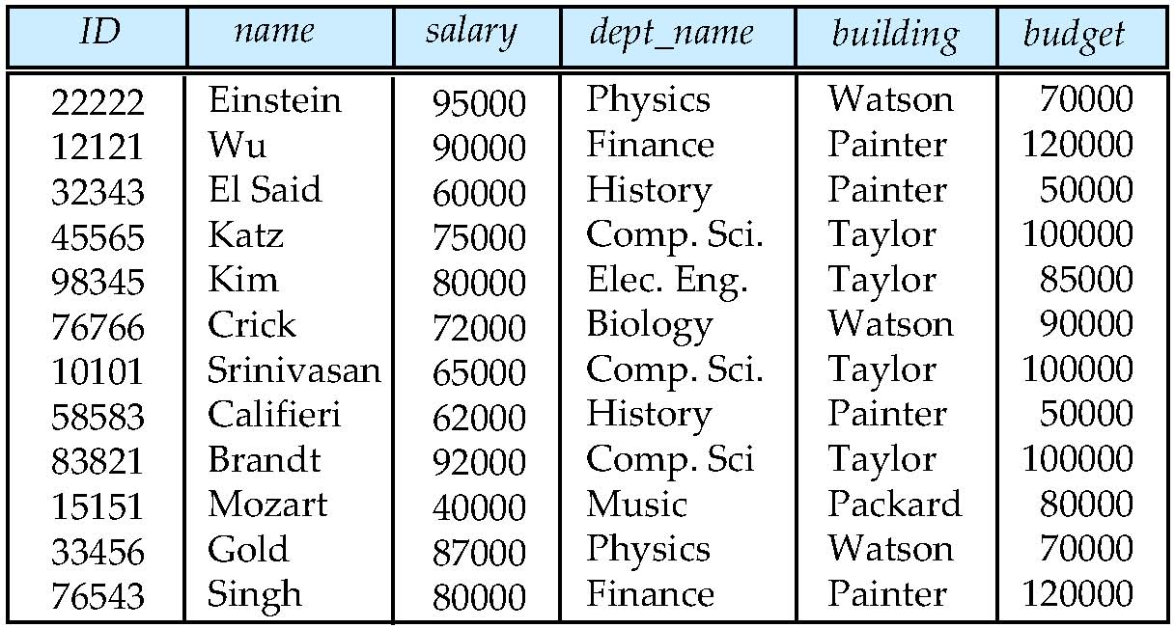
Database Design?
Is there any problem with this design?
Notes:
27

Slide 28
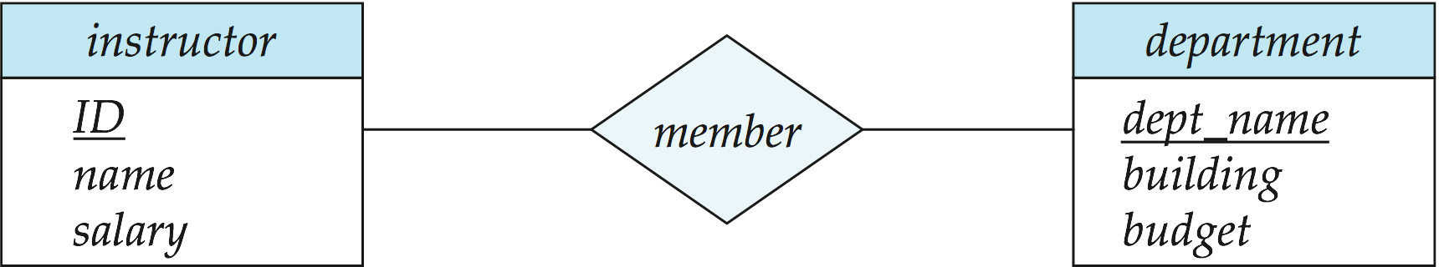
Design Approaches
Normalization Theory
Formalize what designs are bad, and test for them
Entity Relationship Model
Models an enterprise as a collection of entities and relationships
Entity: a “thing” or “object” in the enterprise that is distinguishable from other objects
Described by a set of attributes
Relationship: an association among several entities
Represented diagrammatically by an entity-relationship diagram:
Notes:
28

Slide 29
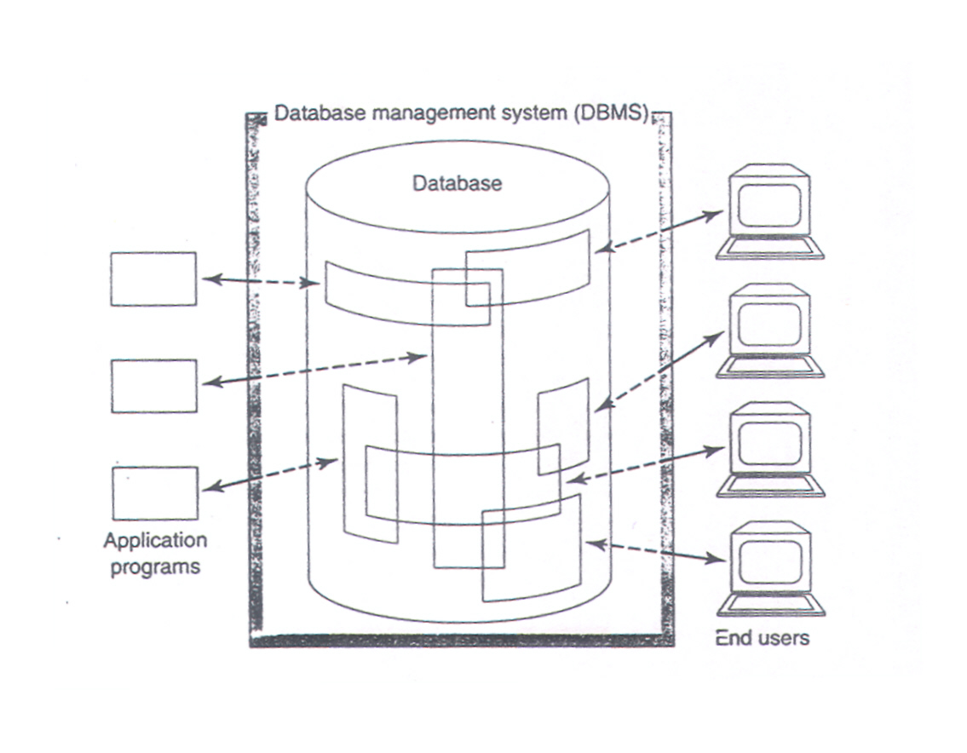
Database System (simplified) (C.J. Date, An Introduction to Database System)
Components of database system:
Data
Hardware
Software
Users

Slide 30
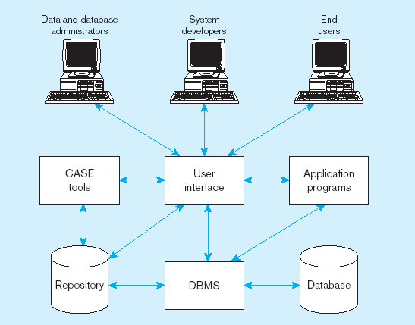
Figure 1-5 Components of the Database Environment

Slide 31
Components of the Database Environment
CASE Tools–computer-aided software engineering
Repository–centralized storehouse of metadata
Database Management System (DBMS) –software for managing the database
Database–storehouse of the data
Application Programs–software using the data
User Interface–text and graphical displays to users
Data/Database Administrators–personnel responsible for maintaining the database
System Developers–personnel responsible for designing databases and software
End Users–people who use the applications and databases

Slide 32
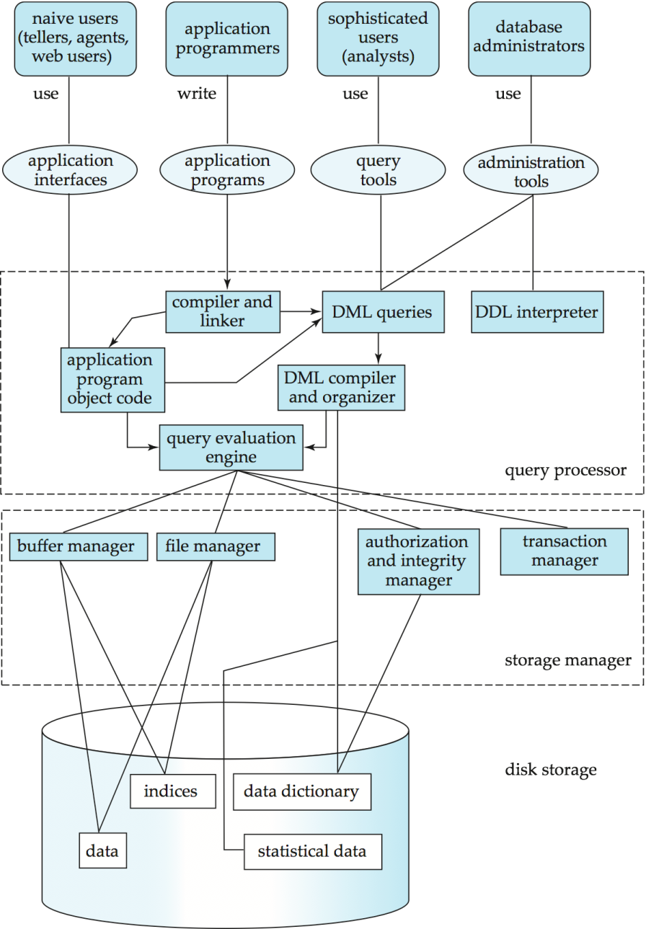
Database System Internals
Notes:
32

Slide 33
Storage Management
Storage manager is a program module that provides the interface between the low-level data stored in the database and the application programs and queries submitted to the system.
The storage manager is responsible to the following tasks:
Interaction with the file manager
Efficient storing, retrieving and updating of data
Issues:
Storage access
File organization
Indexing and hashing
Notes:
33

Slide 34
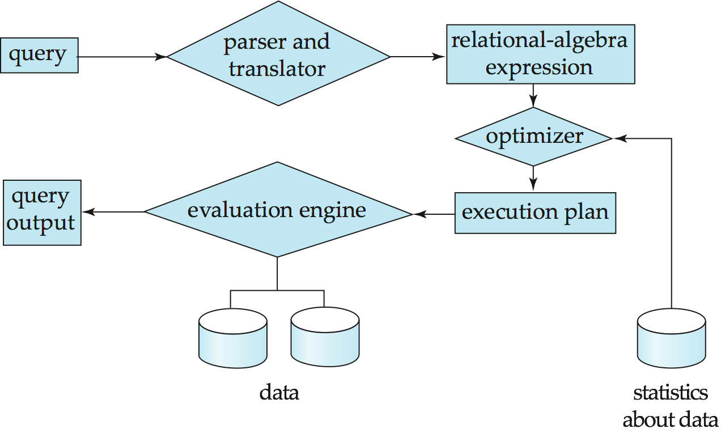
Query Processing
1. Parsing and translation
2. Optimization
3. Evaluation
Notes:
34

Slide 35
Query Processing (Cont.)
Alternative ways of evaluating a given query
Equivalent expressions
Different algorithms for each operation
Cost difference between a good and a bad way of evaluating a query can be enormous
Need to estimate the cost of operations
Depends critically on statistical information about relations which the database must maintain
Need to estimate statistics for intermediate results to compute cost of complex expressions
Notes:
35
- Enormous = sangat besar

Slide 36
Transaction Management
What if the system fails?
What if more than one user is concurrently updating the same data?
A transaction is a collection of operations that performs a single logical function in a database application
Transaction-management component ensures that the database remains in a consistent (correct) state despite system failures (e.g., power failures and operating system crashes) and transaction failures.
Concurrency-control manager controls the interaction among the concurrent transactions, to ensure the consistency of the database.
Notes:
36
Concurrently = bersamaan/serentak

Slide 37
Database Users
Users are differentiated by the way they expect to interact with the system:
Application programmers – interact with system through DML calls
Sophisticated users – form requests in a database query language
Specialized users – write specialized database applications that do not fit into the traditional data processing framework
Naive users – invoke one of the permanent application programs that have been written previously

Slide 38
Database Administrator
Coordinates all the activities of the database system; the database administrator has a good understanding of the enterprise’s information resources and needs.
Database administrator's duties include:
Schema definition
Storage structure
Schema & physical organization modification
Granting user authority to access DB
Specifying integrity constraints

Slide 39
Database Systems Architecture
The architecture of a database system is greatly influenced by the underlying computer system on which the database is running:
Centralized
Client-server
Parallel (multi-processor)
Distributed
Notes:
39

Slide 40
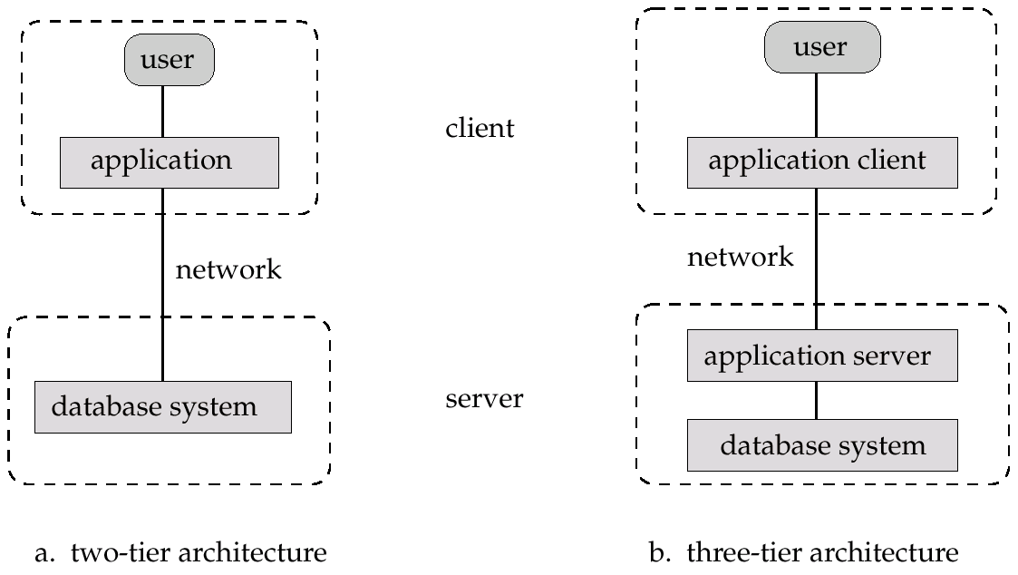
Application Architectures
Two-tier architecture: E.g. client programs using ODBC/JDBC to communicate with a database
Three-tier architecture: E.g. web-based applications, and applications built using “middleware”

Slide 41
The Range of Database Applications
Personal databases
Workgroup databases
Departmental/divisional databases
Enterprise database

Slide 42
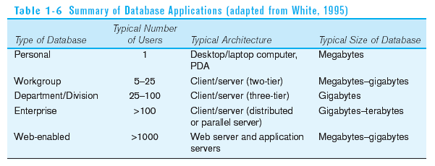

Slide 43
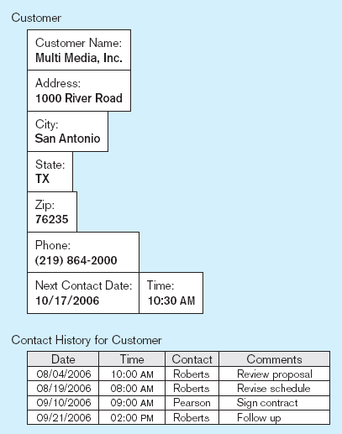
Typical data from a personal database

Slide 44
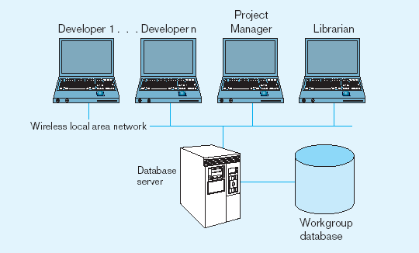
Workgroup database with wireless
local area network

Slide 45
Enterprise Database Applications
Enterprise Resource Planning (ERP)
Integrate all enterprise functions (manufacturing, finance, sales, marketing, inventory, accounting, human resources)
Data Warehouse
Integrated decision support system derived from various operational databases

Slide 46
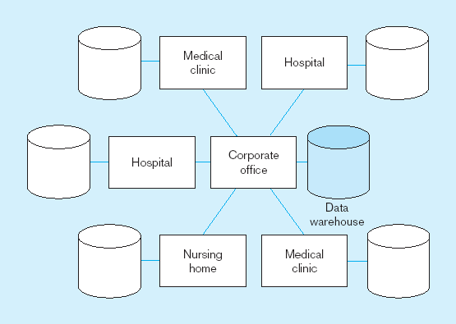
An enterprise data warehouse

Slide 47
History of Database Systems
1950s and early 1960s:
Data processing using magnetic tapes for storage
Tapes provided only sequential access
Punched cards for input
Late 1960s and 1970s:
Hard disks allowed direct access to data
Network and hierarchical data models in widespread use
Ted Codd defines the relational data model
Would win the ACM Turing Award for this work
IBM Research begins System R prototype
UC Berkeley begins Ingres prototype
High-performance (for the era) transaction processing
Notes:
47

Slide 48
History (cont.)
1980s:
Research relational prototypes evolve into commercial systems
SQL becomes industrial standard
Parallel and distributed database systems
Object-oriented database systems
1990s:
Large decision support and data-mining applications
Large multi-terabyte data warehouses
Emergence of Web commerce
Early 2000s:
XML and XQuery standards
Automated database administration
Later 2000s:
Giant data storage systems
Google BigTable, Yahoo PNuts, Amazon, ..
Notes:
48

Slide 49
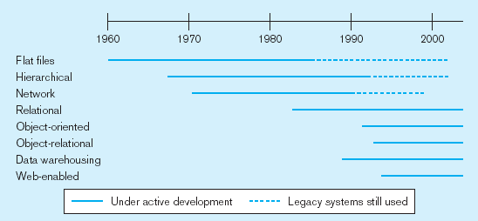
Evolution of DB Systems

